Slide 1

Data Mining Clustering
İnanç Arın
Slides were prepared by Yücel Saygın

Slide 2
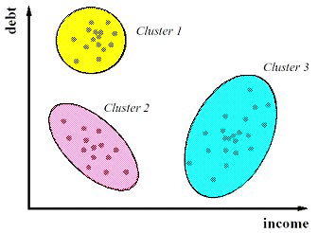
Clustering
A descriptive data mining method
Groups a given dataset into smaller clusters, where the data inside the clusters are similar to each other while the data belonging to different clusters are dissimilar

Slide 3
Clustering
Similar to classification in a sense but this time we do not know the labels of clusters. Therefore it is an unsupervised method.

Slide 4
Clustering
Lets go back to the retail market example. How can we segment our customers with respect to their profiles and shopping behaviour.

Slide 5
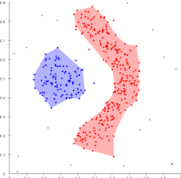
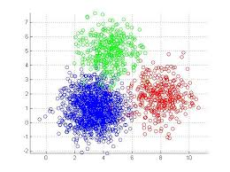
What Is Good Clustering?
A good clustering method will produce high quality clusters with
high intra-class similarity
low inter-class similarity
‹#›

Slide 6
What Is Good Clustering?
The quality of a clustering result depends on both the similarity/distance measure used by the method and its implementation.
‹#›

Slide 7
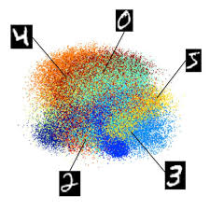
What Is Good Clustering?
The quality of a clustering method is also measured by its ability to discover some or all of the hidden patterns.
‹#›

Slide 8
Requirements of Clustering in Data Mining
Scalability
Ability to deal with different types of attributes
Discovery of clusters with arbitrary shape
Able to deal with noise and outliers
Insensitive to order of input records
High dimensionality
Interpretability and usability
‹#›

Slide 9
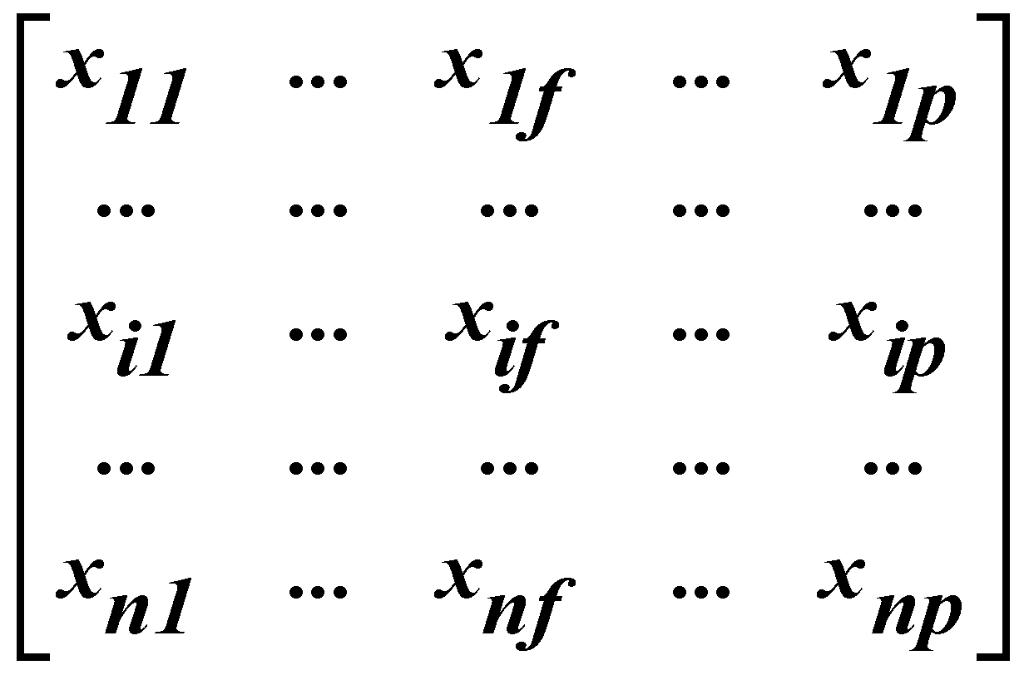
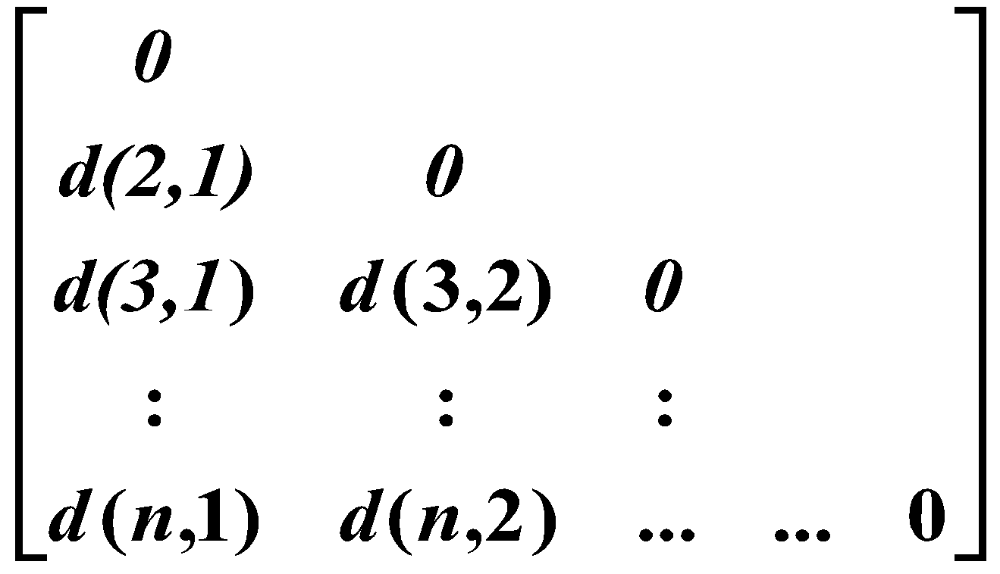
Data Structures
Data matrix
Dissimilarity matrix
‹#›

Slide 10
Measure the Quality of Clustering
Dissimilarity/Similarity metric: Similarity is expressed in terms of a distance function: d(i, j)
The definitions of distance functions are usually very different for:
boolean,
categorical,
ordinal,
interval-scale,
Ratio-scale variables.
September 15, 2004
‹#›

Slide 11
Interval-scaled variables
Measurements of continuous value which are roughly linear scale
Observations in equal intervals
Ex: Temperature observations (in Celcius)
There is no real 0 value defined, therefore
Subtraction and addition makes sense (temperature 30-15)
But multiplication does not (is 30 Degrees Celsius twice as hot as 15?)

Slide 12
Ratio-scaled variables
Measurements of continuous value which are roughly linear scale
Weight, height, time units
0 value is defined (Even if it is not observed like the height)

Slide 13
For interval and ratio-scaled variables
Measurement may be with different standards (kilo, pound, F vs C etc)
Measurements could be relative (like time)
Unit of representation may change the clustering result (ex. meters vs milimeters)
Therefore standardization of the data is needed

Slide 14
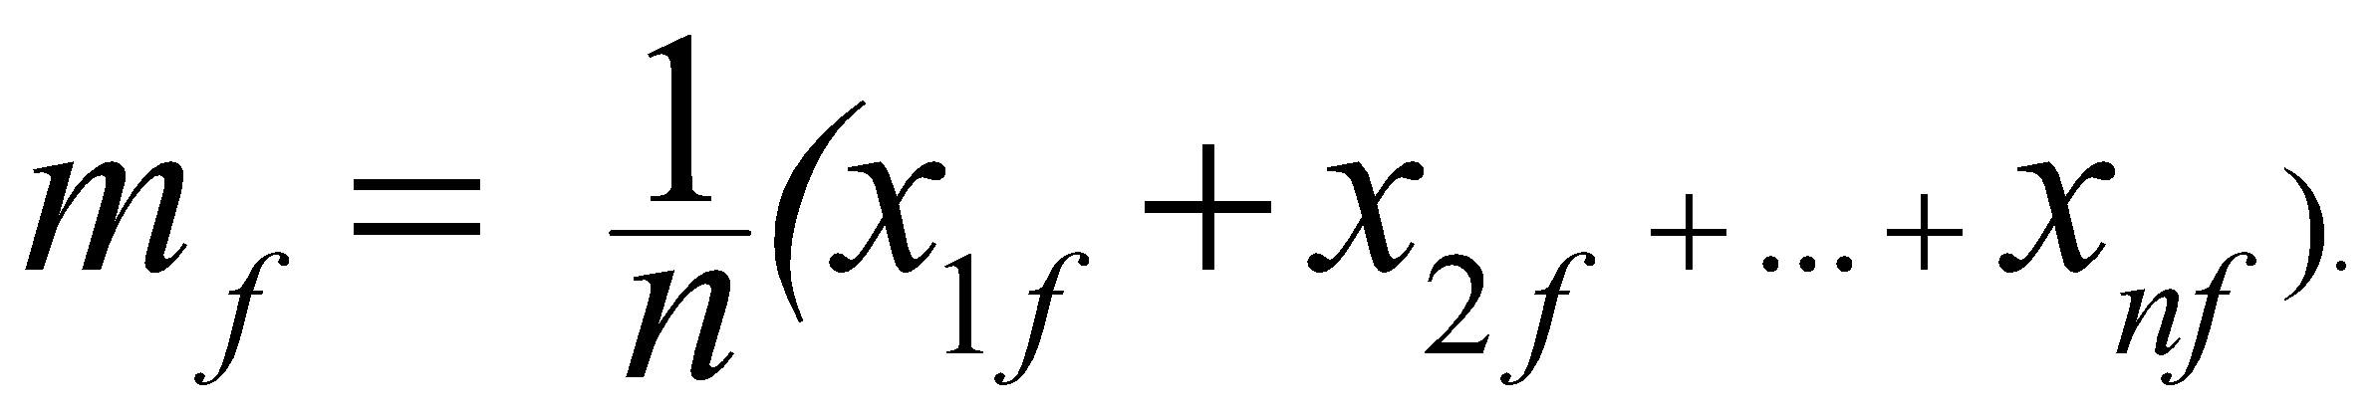
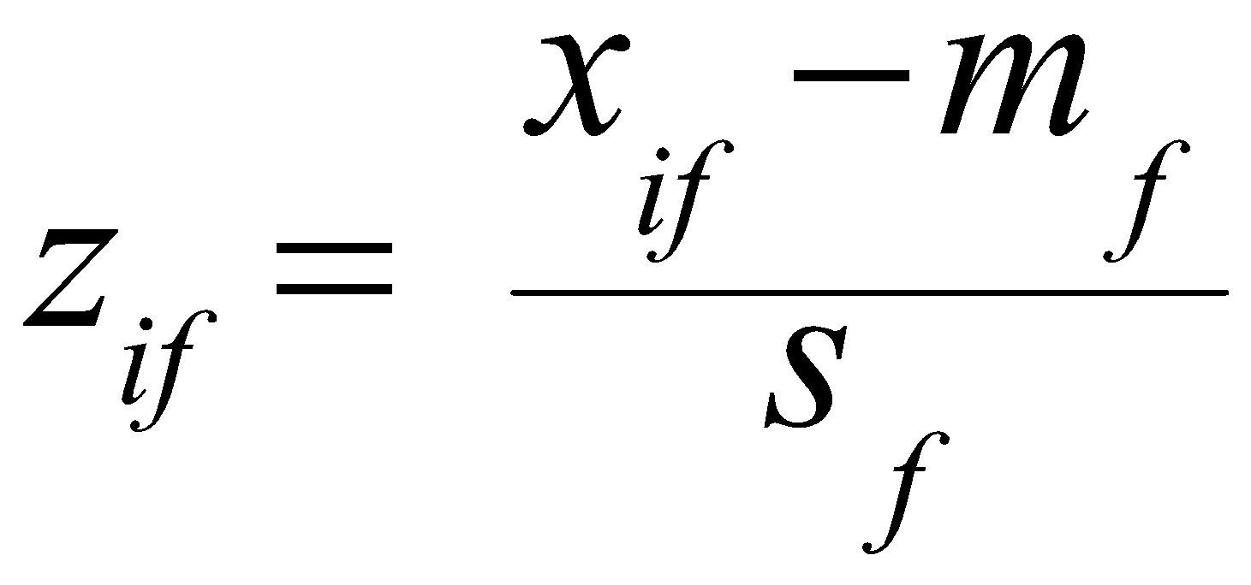
Interval-scaled variables
Standardize data
Calculate the mean absolute deviation:
where
Calculate the standardized measurement (z-score)
Using mean absolute deviation is more robust than using standard deviation

Slide 15
Similarity/Distance between objects
Euclidean Space: points are represented by real valued numbers in each dimension
Euclidean Distance is based on the locations of the points in Euclidean Space
In case the data points are in non Euclidean Space, then distance is measured wrt the properties of the points.

Slide 16
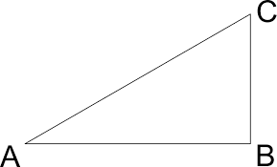
Properties of a distance function
d(i,j) ≥ 0
d(i,i) = 0
d(i,j) = d(j,i)
d(i,j) ≤ d(i,k) + d(k,j)

Slide 17
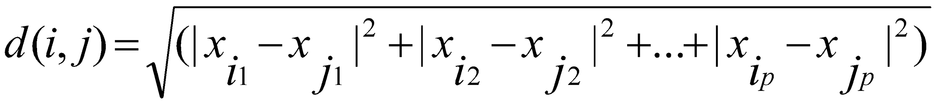
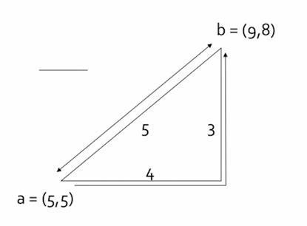
Similarity and Dissimilarity Between Objects (Cont.)
L2-Norm (The Euclidean distance)
In case of one dimension

Slide 18
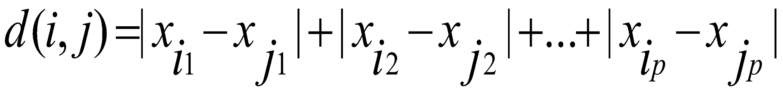
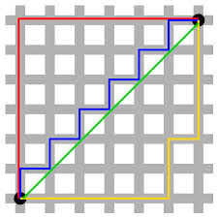
Similarity and Dissimilarity Between Objects
Manhattan distance (L1-Norm): Sum of differences in each dimension.
This is the distance if you had to travel along the coordinates only

Slide 19
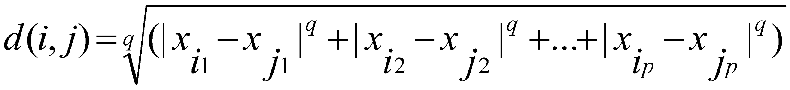
Similarity and Dissimilarity Between Objects (Cont.)
In general Lq-Norm
L∞Norm d(x,y) is the maximum of the differences between x and y in any dimension

Slide 20
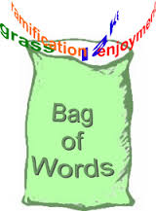
Similarity Between Sets
Sets can be represented as a vectors of binary variables
Documents can be represented as a set of words

Slide 21
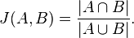
Similarity Between Sets
Jaccard Similarity between sets

Slide 22
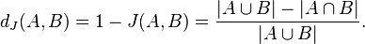
Distance Between Sets
Jaccard Distance between sets

Slide 23
Similarity Between Sets
Sets can be represented as a vectors of binary variables
Documents can be represented as a set of words

Slide 24
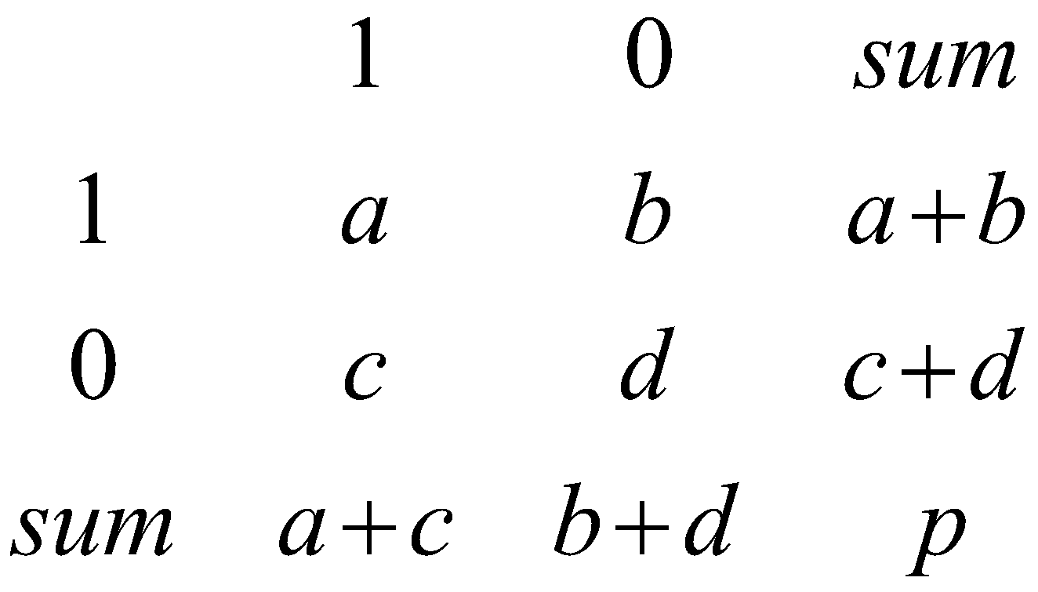
Binary Variables
A contingency table for binary data
Hamming distance is b + c
Object j
Object i

Slide 25
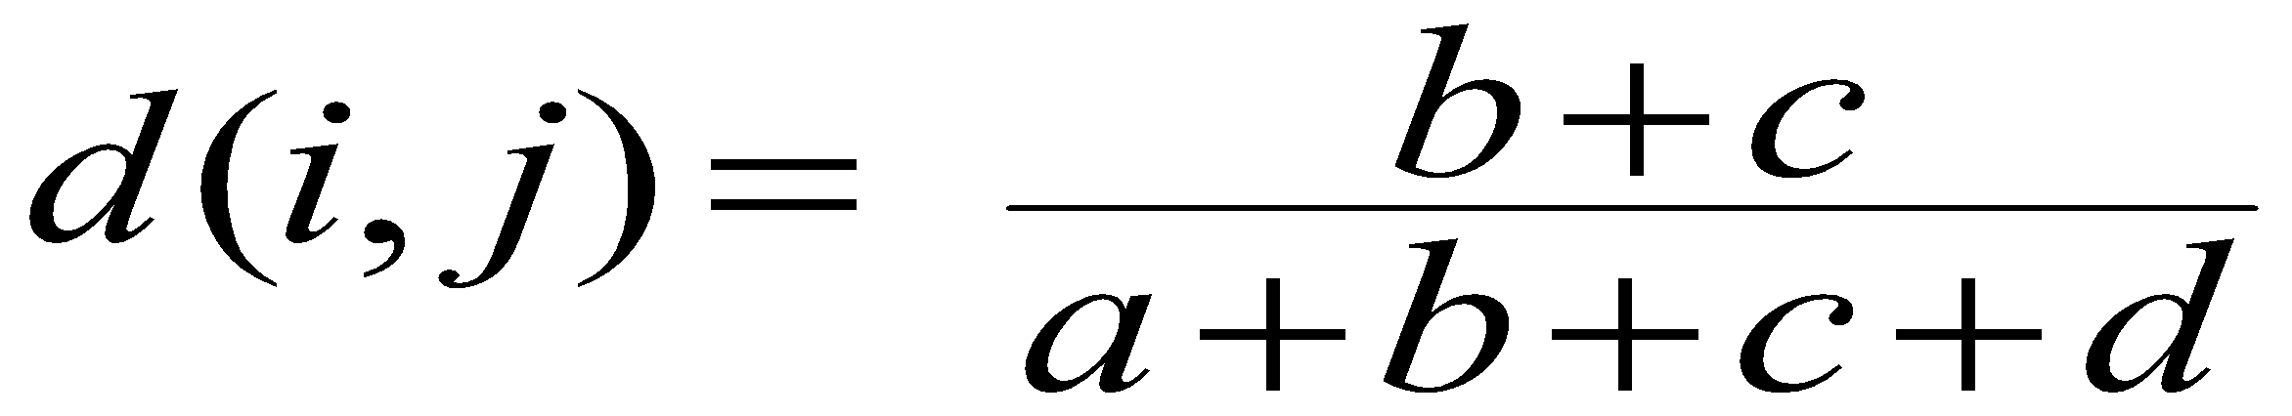
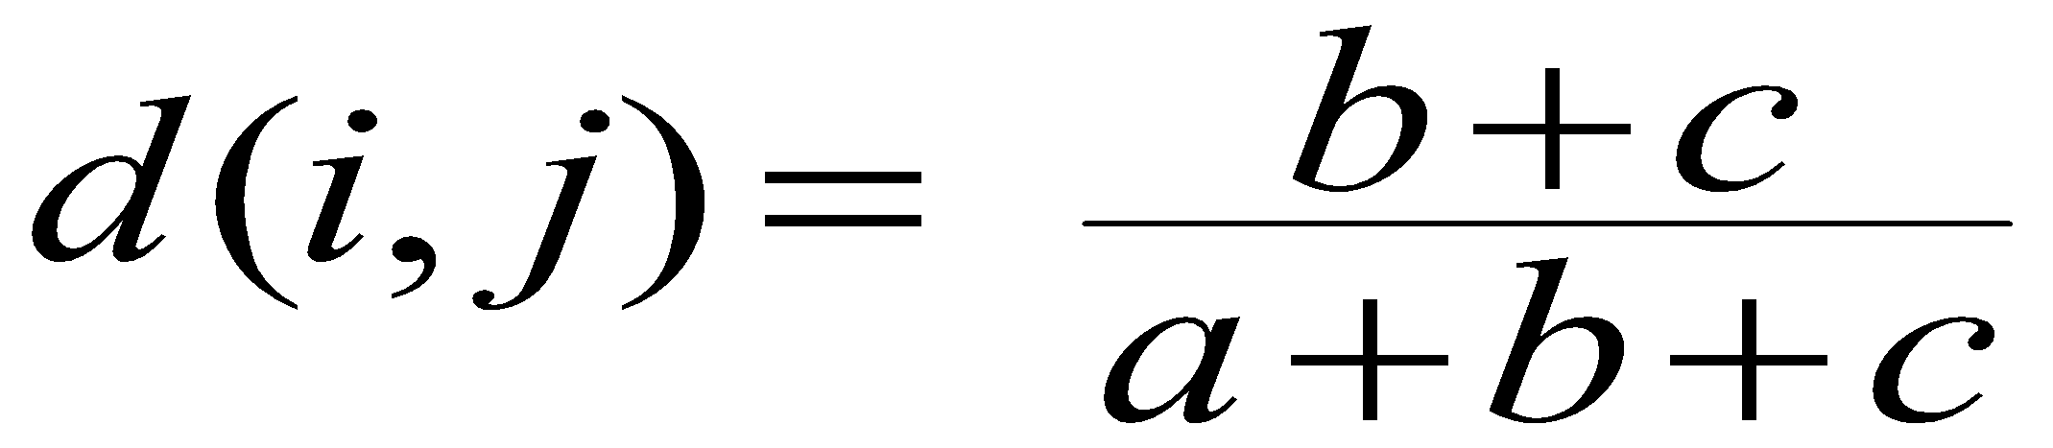
Binary Variables
A contingency table for binary data
Simple matching coefficient (invariant, if the binary variable is symmetric):
Jaccard coefficient (noninvariant if the binary variable is asymmetric):
Object j
Object i
Notes:
https://www.coursera.org/lecture/cluster-analysis/2-3-proximity-measure-for-symetric-vs-asymmetric-binary-variables-r9vZf

Slide 26
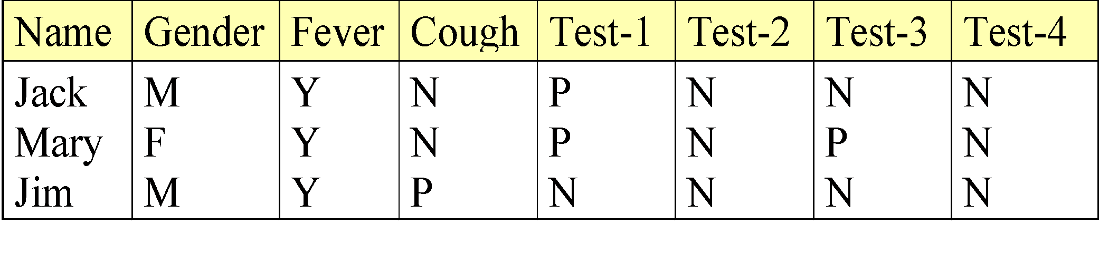
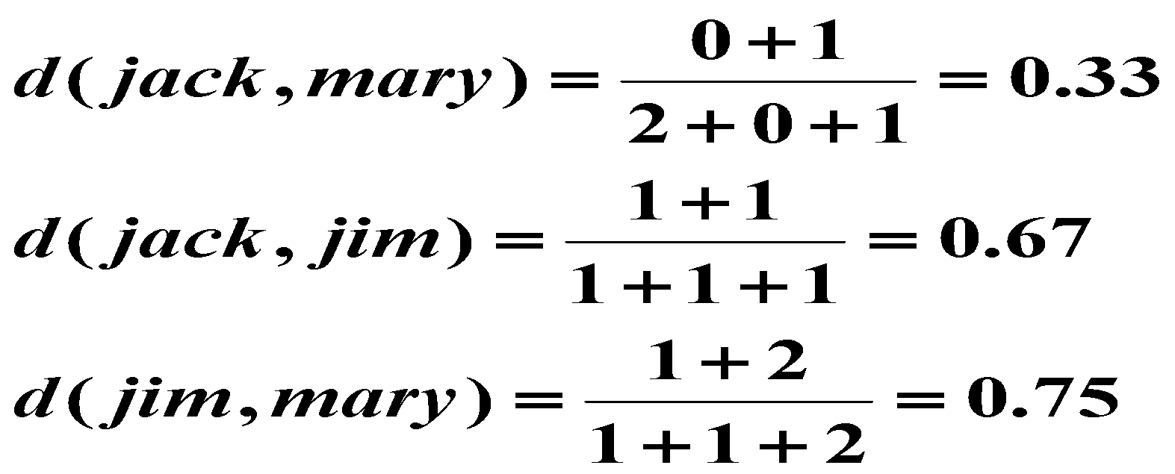
Dissimilarity between Binary Variables
Example
gender is a symmetric attribute
the remaining attributes are asymmetric binary
let the values Y and P be set to 1, and the value N be set to 0

Slide 27
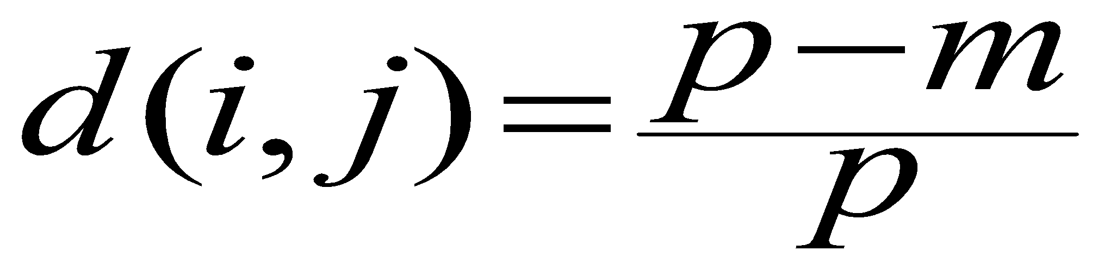
Nominal Variables
A generalization of the binary variable in that it can take more than 2 states, e.g., red, yellow, blue, green
Method 1: Simple matching
m: # of matches, p: total # of variables
Method 2: use a large number of binary variables
creating a new binary variable for each of the M nominal states

Slide 28
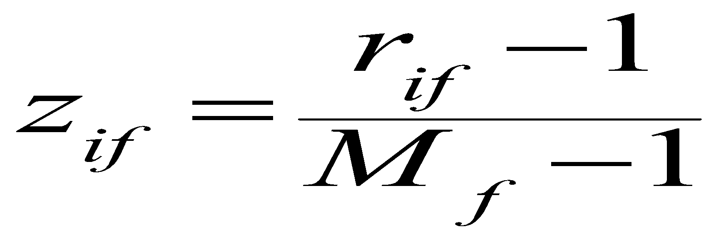
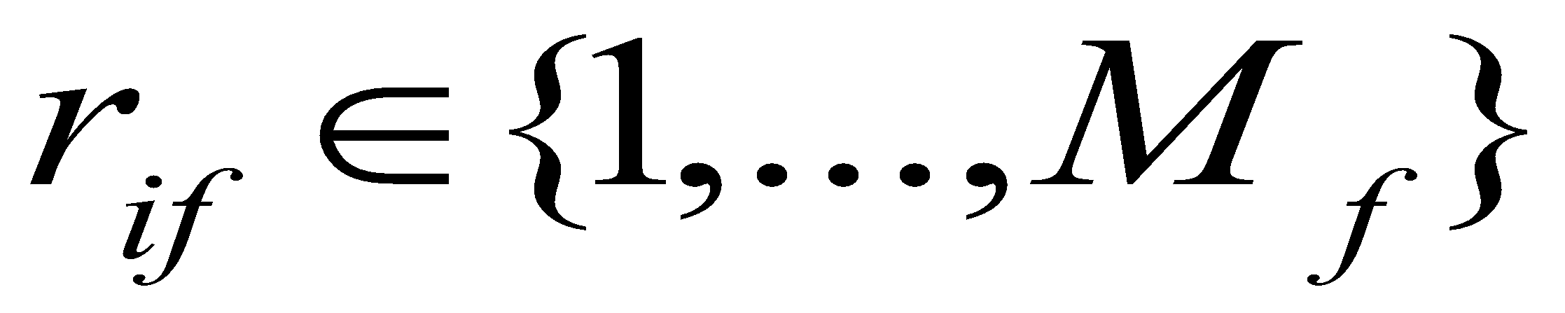
Ordinal Variables
An ordinal variable can be discrete or continuous
order is important, e.g., rank
Can be treated like interval-scaled
replacing x_{if} by their rank
map the range of each variable onto [0, 1] by replacing i-th object in the f-th variable by
compute the dissimilarity using methods for interval-scaled variables

Slide 29
Ratio-Scaled Variables with exponential scale
Ratio-scaled variable: a positive measurement on a nonlinear scale, approximately at exponential scale, such as Ae^{Bt} or Ae^{-Bt}
Methods:
treat them like interval-scaled variables — not a good choice! (why?)
apply logarithmic transformation
y_{if} = log(x_{if})
treat them as continuous ordinal data treat their rank as interval-scaled.
‹#›

Slide 30
Strings
Edit Distance Between Strings: The minimum number of insertions and deletions to convert one string to the other
LCS (Longest Common Subsequence) for two strings: Longest Subsequence (not necessarily consecutive characters) Common to both strings
Edit Distance between x and y, d(x,y) = |x| + |y| - 2|LCS(x,y)|
EX: x = "abcde" y = "bcduve"
Edit distance is 3
LCS is bcde
‹#›

Slide 31
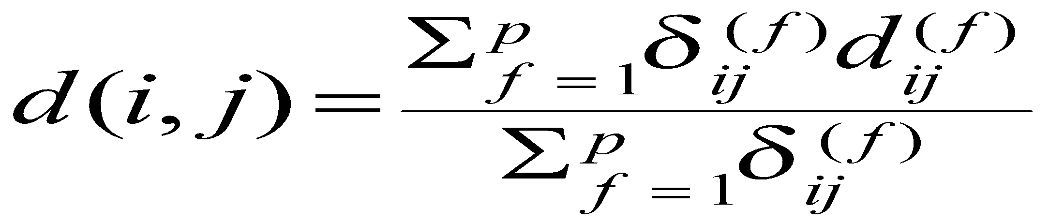
Similarity and Dissimilarity Between Objects (Cont.)
Also, one can use weighted distance, parametric
‹#›

Slide 32
Measure the Quality of Clustering
Dissimilarity/Similarity metric: Similarity is expressed in terms of a distance function, which is typically metric: d(i, j)
There is a separate “quality” function that measures the “goodness” of a cluster.
The definitions of distance functions are usually very different for interval-scaled, boolean, categorical, ordinal and ratio variables.
Weights should be associated with different variables based on applications and data semantics.
It is hard to define “similar enough” or “good enough”
the answer is typically highly subjective.
‹#›

Slide 33
Clustering Approaches
Clustering
Hierarchical
Partitional
Categorical
Large DB
Agglomerative
Divisive
Sampling
Compression

Slide 34
Major Clustering Approaches
Partitioning algorithms: Construct various partitions and then evaluate them by some criterion
Hierarchical algorithms: Create a hierarchical decomposition of the set of data (or objects) using some criterion
Density-based: based on connectivity and density functions
‹#›

Slide 35
Partitioning Algorithms: Basic Concept
Partitioning method: Construct a partition of a database D of n objects into a set of k clusters
Given a k, find a partition of k clusters that optimizes the chosen partitioning criterion
Global optimal: exhaustively enumerate all partitions
Heuristic methods: k-means and k-medoids algorithms
k-means (MacQueen’67): Each cluster is represented by the center of the cluster
k-medoids or PAM (Partition around medoids) (Kaufman & Rousseeuw’87): Each cluster is represented by one of the objects in the cluster
‹#›

Slide 36
The K-Means Clustering Method
Given k, the k-means algorithm is implemented in four steps:
Partition objects into k nonempty subsets
Compute seed points as the centroids of the clusters of the current partition (the centroid is the center, i.e., mean point, of the cluster)
Assign each object to the cluster with the nearest seed point
Go back to Step 2, stop when no more new assignment
‹#›

Slide 37
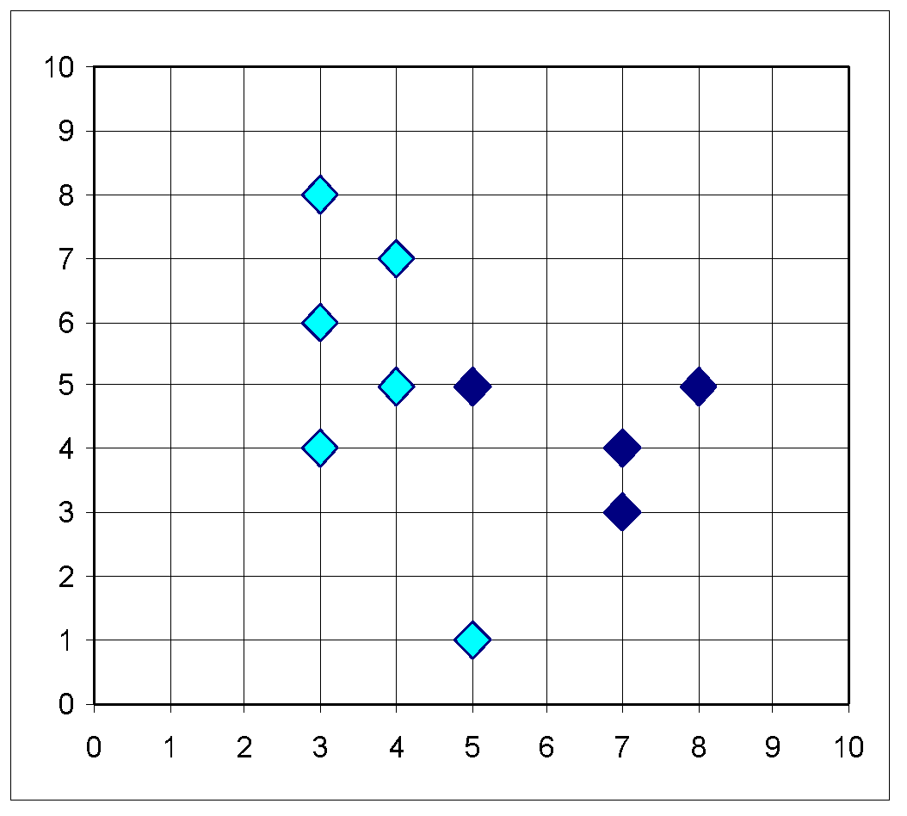
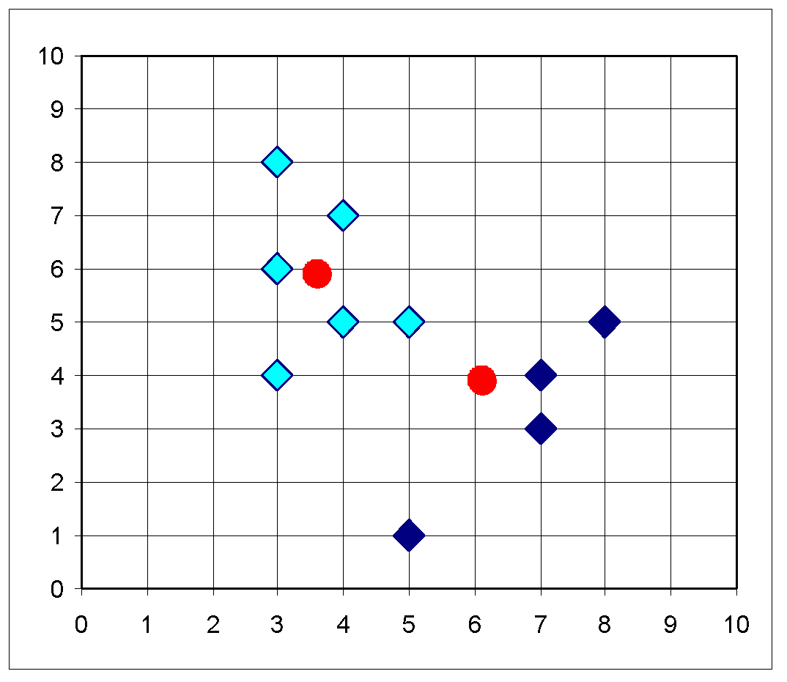
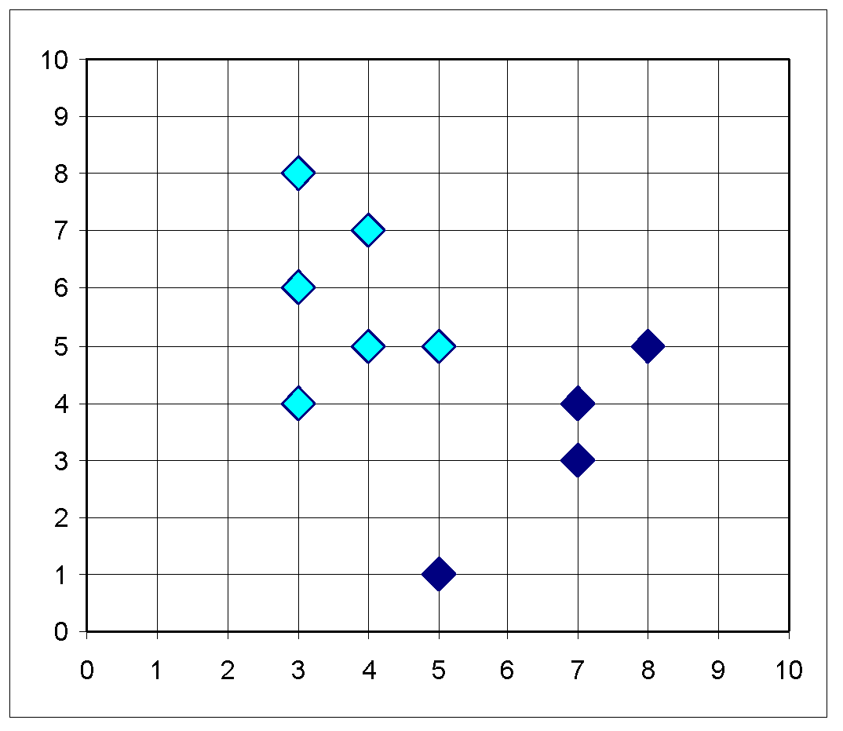
The K-Means Clustering Method
Example
10
10
9
9
8
8
7
7
6
6
5
5
4
Assign each objects to most similar center
Update the cluster means
4
3
3
2
2
1
1
0
0
0
1
2
3
4
5
6
7
8
9
10
0
1
2
3
4
5
6
7
8
9
10
reassign
reassign
K=2
Arbitrarily choose K object as initial cluster center
Update the cluster means
‹#›

Slide 38
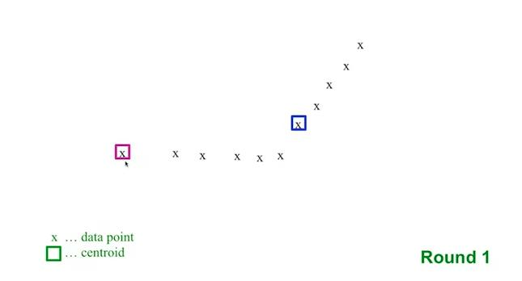
The K-Means Clustering Example
‹#›

Slide 39
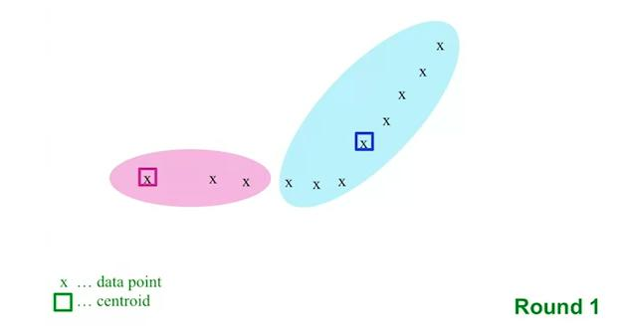
The K-Means Clustering Example
‹#›

Slide 40
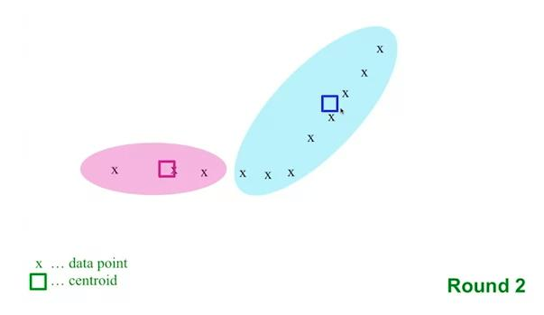
The K-Means Clustering Example
‹#›

Slide 41
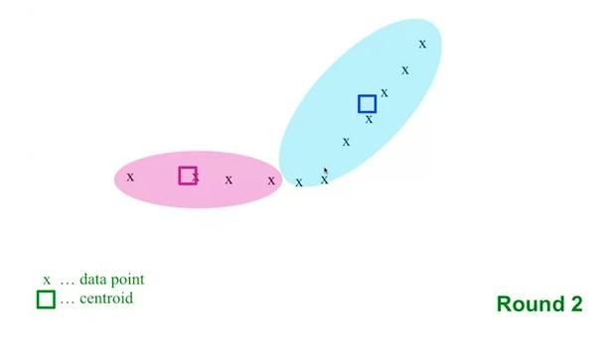
The K-Means Clustering Example
‹#›

Slide 42
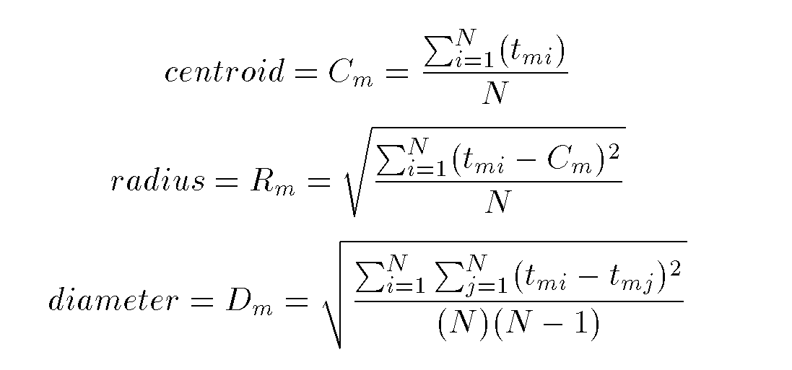
Cluster Summary Parameters

Slide 43
K-Means Example
Given: {2,4,10,12,3,20,30,11,25}, k=2
Randomly assign means: m₁=3,m₂=4
Solve for the rest ….

Slide 44
Comments on the K-Means Method
How to choose k for k-means clustering?
Choose different k and see how the avg distance to centroid changes as k increases
‹#›

Slide 45
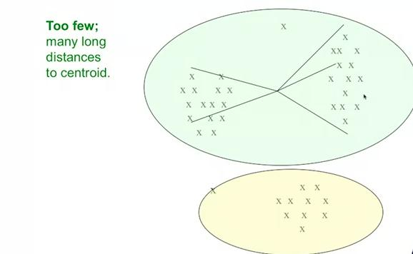
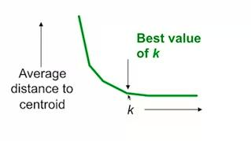
Comments on the K-Means Method
‹#›

Slide 46
Comments on the K-Means Method
How to choose the initial k points?
Try to pick points that are far from each other
First pick a random point
Continue picking a point whose minimum distance to the selected points is farthest
Repeat until k points are reached
‹#›

Slide 47
Comments on the K-Means Method
How to choose the initial k points?
Pick a sample set of points and apply an expensive clustering method then pick the k points from each cluster
‹#›

Slide 48
Variations of the K-Means Method
A few variants of the k-means which differ in
Selection of the initial k means
Dissimilarity calculations
Strategies to calculate cluster means

Slide 49
Comments on the K-Means Method
Complexity of k-means
At each round we need to check each point for the closest centroid which is O(kN)
The number of rounds for the algorithm to converge is not bouned
O(tkn), where n is # objects, k is # clusters, and t is # iterations. Normally, k, t << n.
‹#›

Slide 50
Comments on the K-Means Method
Strength: Relatively efficient: O(tkn), where n is # objects, k is # clusters, and t is # iterations. Normally, k, t << n.
Comparing: PAM: O(k(n-k)² ), CLARA: O(ks² + k(n-k))
Comment: Often terminates at a local optimum. The global optimum may be found using techniques such as: deterministic annealing and genetic algorithms
Weakness
Applicable only when mean is defined, then what about categorical data?
Need to specify k, the number of clusters, in advance
Unable to handle noisy data and outliers
Not suitable to discover clusters with non-convex shapes
‹#›

Slide 51
Variations of the K-Means Method
Handling categorical data: k-modes (Huang’98)
Replacing means of clusters with modes
Using new dissimilarity measures to deal with categorical objects
Using a frequency-based method to update modes of clusters
A mixture of categorical and numerical data: k-prototype method

Slide 52
Variations of the K-Means Method
Expectation Maximization
Each object is assigned to each cluster according to a weight representing its probability of membership
No strict boundaries between clusters
New means are computed based on weighted measures

Slide 53
Some Important Remarks (from scikit-learn)
The KMeans algorithm clusters data by trying to separate samples in n groups of equal variance, minimizing a criterion known as the inertia or within-cluster sum-of-squares.
It suffers from various drawbacks:
Inertia makes the assumption that clusters are convex and isotropic, which is not always the case. It responds poorly to elongated clusters, or manifolds with irregular shapes.
Inertia is not a normalized metric: we just know that lower values are better and zero is optimal. But in very high-dimensional spaces, Euclidean distances tend to become inflated ( “curse of dimensionality”). Running a dimensionality reduction algorithm such as PCA prior to k-means clustering can alleviate this problem and speed up the computations.

Slide 54
Some Important Remarks (from scikit-learn)
Given enough time, K-means will always converge
However this may be to a local minimum. This is highly dependent on the initialization of the centroids. As a result, the computation is often done several times, with different initializations of the centroids. One method to help address this issue is the k-means++ initialization scheme, which has been implemented in scikit-learn (use the init='k-means++' parameter). This initializes the centroids to be (generally) distant from each other, leading to probably better results than random initialization, as shown in the reference.

Slide 55
Mini-batch K-means (from scikit-learn)
a variant of the KMeans algorithm which uses mini-batches to reduce the computation time,
Mini-batches are subsets of the input data, randomly sampled in each training iteration. These mini-batches drastically reduce the amount of computation required to converge to a local solution.
In contrast to other algorithms that reduce the convergence time of k-means, mini-batch k-means produces results that are generally only slightly worse than the standard algorithm.

Slide 56
Mini-batch K-means (from scikit-learn)
In the first step, b samples are drawn randomly from the dataset, to form a mini-batch. These are then assigned to the nearest centroid.
In the second step, the centroids are updated. In contrast to k-means, this is done on a per-sample basis.
For each sample in the mini-batch, the assigned centroid is updated by taking the streaming average of the sample and all previous samples assigned to that centroid.
This has the effect of decreasing the rate of change for a centroid over time. These steps are performed until convergence or a predetermined number of iterations is reached.

Slide 57
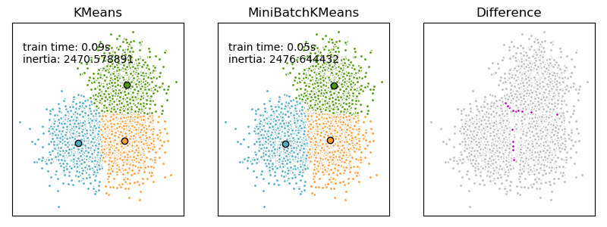
Mini-batch K-means (from scikit-learn)

Slide 58
What is the problem of k-Means Method?
The k-means algorithm is sensitive to outliers !
Since an object with an extremely large value may substantially distort the distribution of the data.
K-Medoids: Instead of taking the mean value of the object in a cluster as a reference point, medoids can be used, which is the most centrally located object in a cluster.
10
10
9
9
8
8
7
7
6
6
5
5
4
4
3
3
2
2
1
1
0
0
1
2
3
4
5
6
7
8
9
10
0
0
1
2
3
4
5
6
7
8
9
10

Slide 59
The K-Medoids Clustering Method
Find representative objects, called medoids, in clusters
PAM (Partitioning Around Medoids, 1987)
starts from an initial set of medoids and iteratively replaces one of the medoids by one of the non-medoids if it improves the total distance of the resulting clustering
PAM works effectively for small data sets, but does not scale well for large data sets
CLARA (Kaufmann & Rousseeuw, 1990)
CLARANS (Ng & Han, 1994): Randomized sampling
Focusing + spatial data structure (Ester et al., 1995)

Slide 60
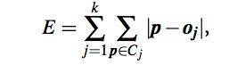
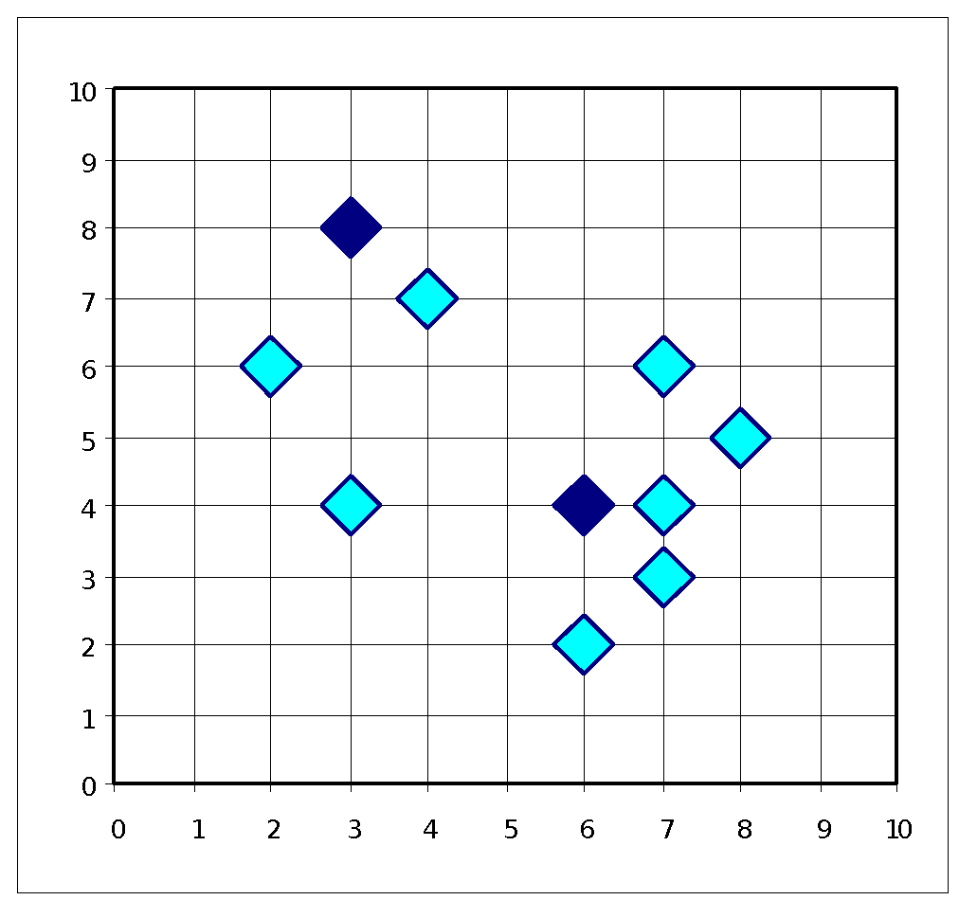
The K-Medoids Clustering Method
Tries to minimize the absolute error

Slide 61
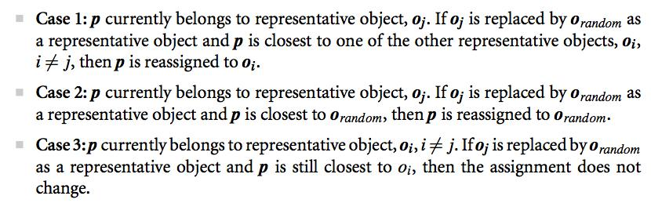
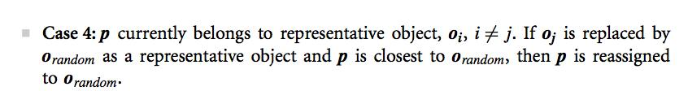
The K-Medoids Clustering Method

Slide 62
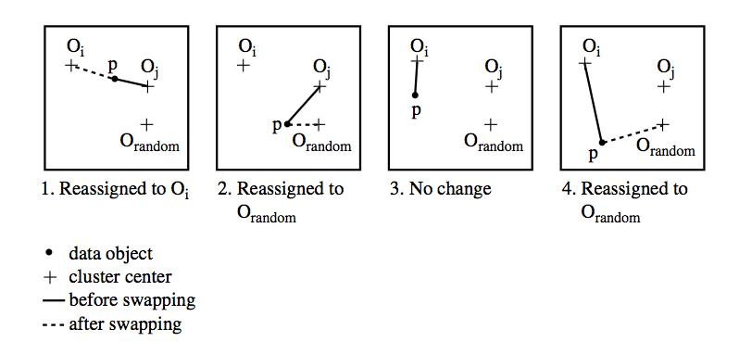
The K-Medoids Clustering Method

Slide 63
Typical k-medoids algorithm (PAM)
Total Cost = 20
10
9
8
Arbitrary choose k object as initial medoids
Assign each remaining object to nearest medoids
7
6
5
4
3
2
1
0
0
1
2
3
4
5
6
7
8
9
10
K=2
Randomly select a nonmedoid object,O_{ramdom}
Total Cost = 26
Do loop
Until no change
10
10
9
Compute total cost of swapping
9
Swapping O and O_{ramdom}
If quality is improved.
8
8
7
7
6
6
5
5
4
4
3
3
2
2
1
1
0
0
1
2
3
4
5
6
7
8
9
10
0
0
1
2
3
4
5
6
7
8
9
10

Slide 64
PAM Method
Initialize: select k of the n data points as the medoids
Associate each data point to the closest medoid.
While the cost of the configuration decreases:
For each medoid m
for each non-medoid data point o:
Swap m and o, recompute the cost (sum of distances of points to their medoid)
If the total cost of the configuration increased in the previous step, undo the swap

Slide 65
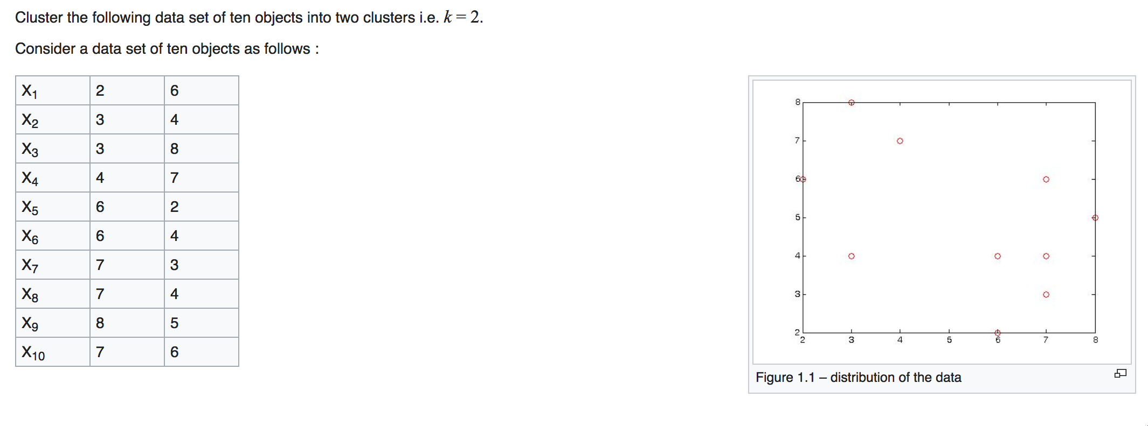
K-medoids example

Slide 66
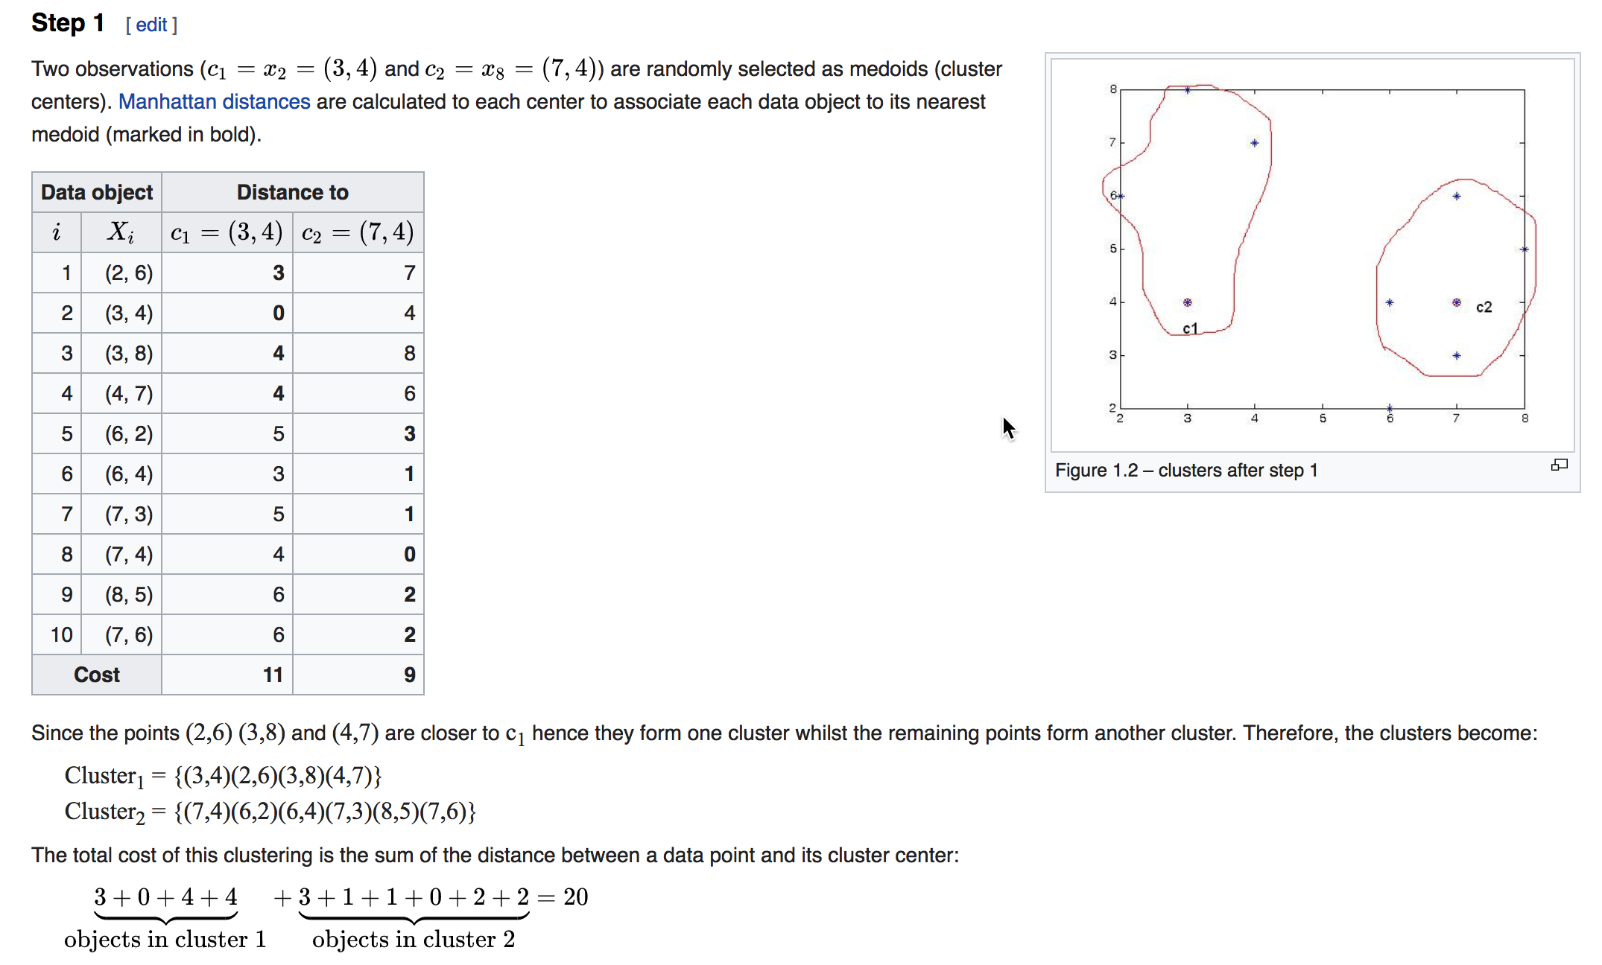

Slide 67
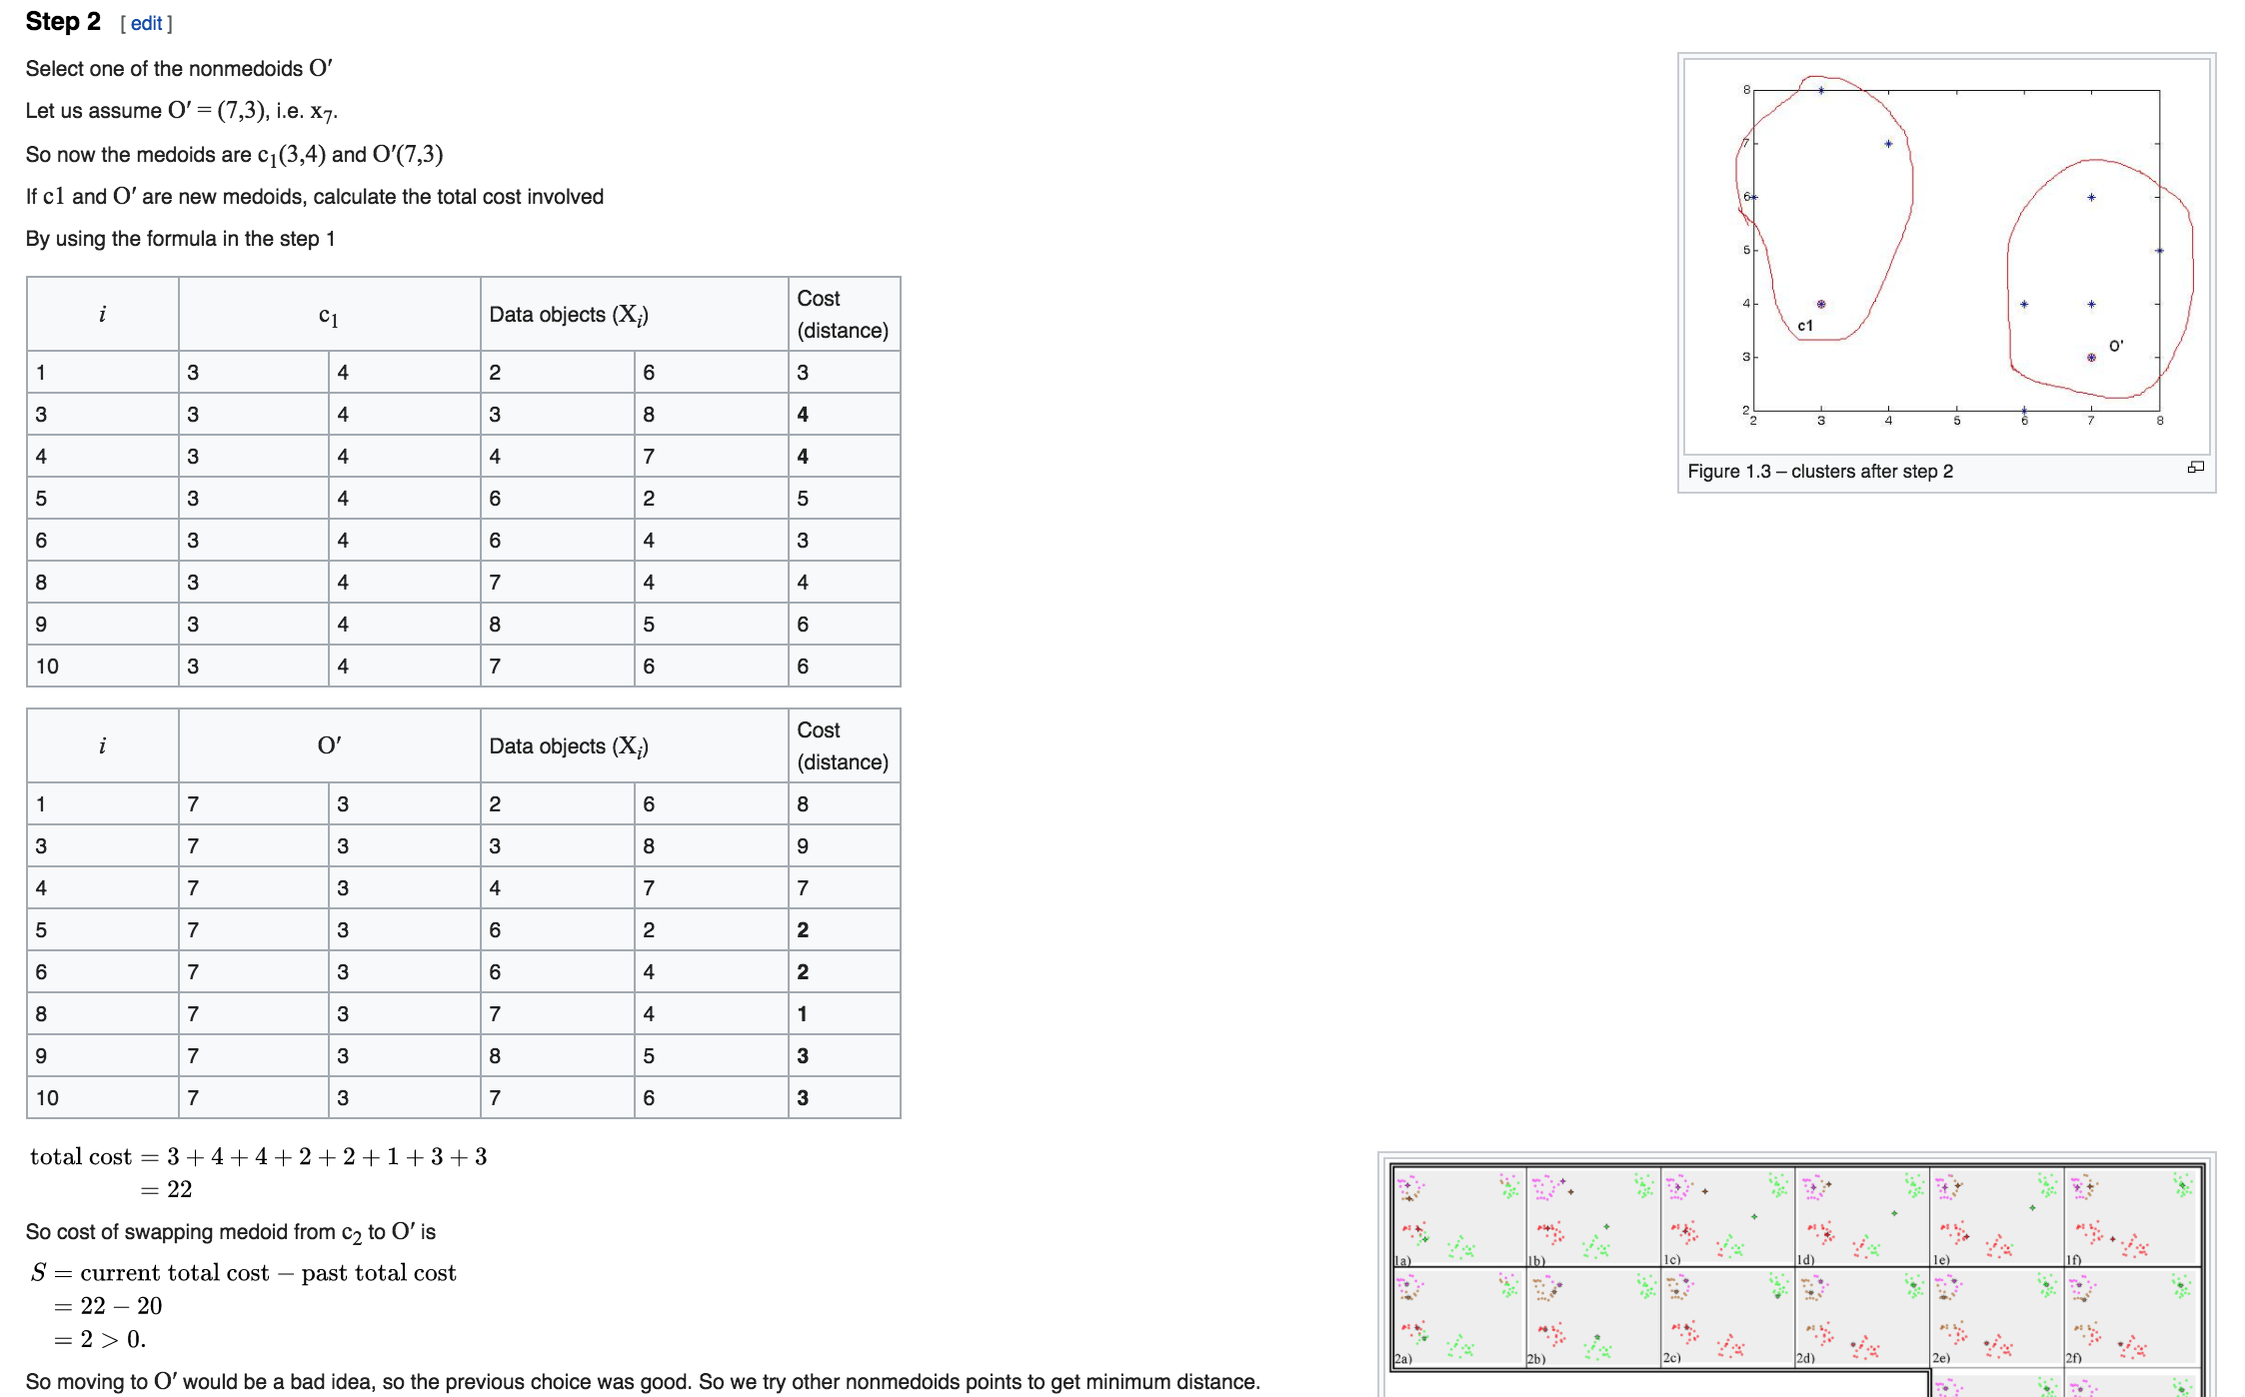


Slide 68
What is the problem with PAM?
Pam is more robust than k-means in the presence of noise and outliers because a medoid is less influenced by outliers or other extreme values than a mean
Pam works efficiently for small data sets but does not scale well for large data sets.
O(k(n-k)² ) for each iteration
where n is # of data,k is # of clusters
Sampling based method,
CLARA(Clustering LARge Applications)

Slide 69
CLARA (Clustering Large Applications) (1990)
CLARA (Kaufmann and Rousseeuw in 1990)
Built in statistical analysis packages, such as S+
It draws multiple samples of the data set, applies PAM on each sample, and gives the best clustering as the output
Strength: deals with larger data sets than PAM
Weakness:
Efficiency depends on the sample size
A good clustering based on samples will not necessarily represent a good clustering of the whole data set if the sample is biased

Slide 70
Clustering Approaches
Clustering
Hierarchical
Partitional
Categorical
Large DB
Agglomerative
Divisive
Sampling
Compression

Slide 71
Cluster Summary Parameters

Slide 72
Hierarchical Clustering
Use distance matrix as clustering criteria. This method does not require the number of clusters k as an input, but needs a termination condition
Step 0
Step 1
Step 2
Step 3
Step 4
agglomerative
(AGNES)
a
a b
b
a b c d e
c
c d e
d
d e
e
divisive
(DIANA)
Step 2
Step 1
Step 0

Slide 73
Hierarchical Clustering
Clusters are created in levels actually creating sets of clusters at each level.
Agglomerative
Initially each item in its own cluster
Iteratively clusters are merged together
Bottom Up
Divisive
Initially all items in one cluster
Large clusters are successively divided
Top Down

Slide 74
Hierarchical Clustering
Three important issues
How to represent a cluster of more than one points?
How do you determine the distance/similarity of clusters?
The stopping criteria

Slide 75
Distance between clusters
Cluster Centroid (Average of points in the cluster)
Centroid is an artificial point
distance between centroids

Slide 76
Distance Between Clusters
In case of non-euclidean space
Clustroid: data point closest to the other points in the cluster

Slide 77
Distance between clusters
Clustroid: closest to other points
Smallest maximum distance to other points
Smallest avg distance to other points
Smallest sum of squares of distances to other points

Slide 78
Distance Between Clusters
In case of non-euclidean space
Single Link: smallest distance between points
Complete Link: largest distance between points
Average Link: average distance between points

Slide 79
Stopping Criteria for Hierarchical Algorithms
Fix the number of clusters you want to obtain (k)
Stop when you merge further, the clusters will not be cohesive
Measures for goodness (cohesion)

Slide 80
Stopping Criteria for Hierarchical Algorithms
Density based stopping criteria
Density: the number of points per volume
Number of points divided by the diameter or radius
Number of points divided by the power of radius

Slide 81
Hierarchical Algorithms
Single Link
MST Single Link
Complete Link
Average Link

Slide 82
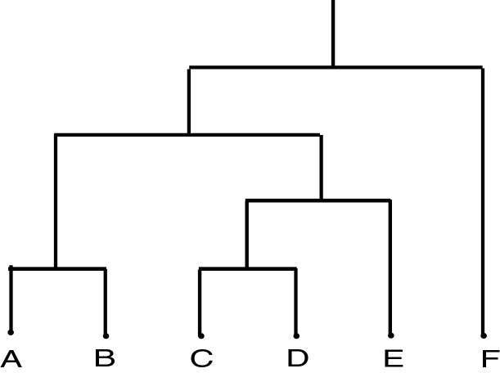
Dendrogram
Dendrogram: a tree data structure which illustrates hierarchical clustering techniques.
Each level shows clusters for that level.
Leaf – individual clusters
Root – one cluster
A cluster at level i is the union of its children clusters at level i+1.

Slide 83
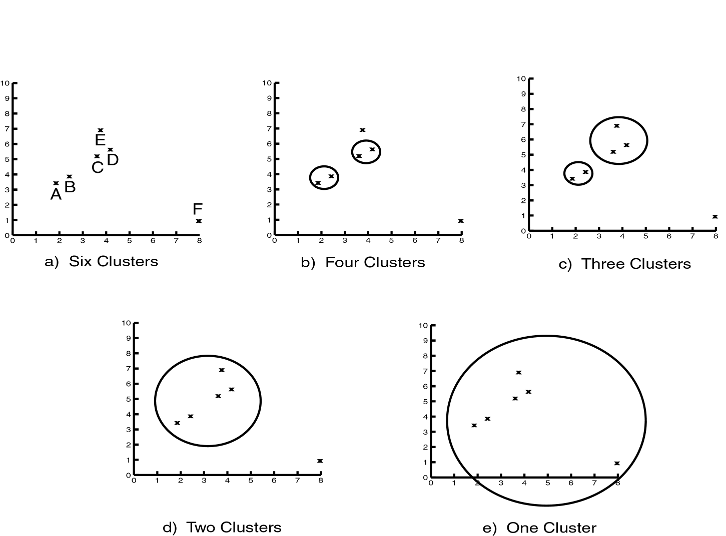
Levels of Clustering

Slide 84
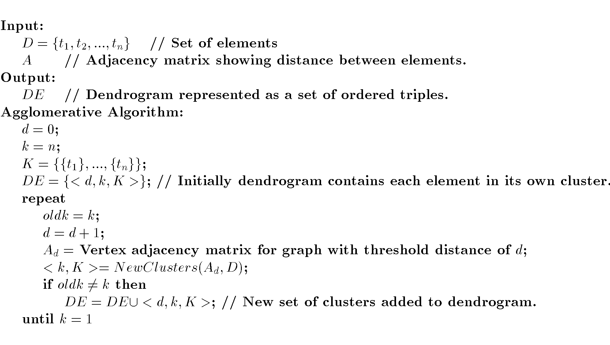
Agglomerative Algorithm

Slide 85
Single Link
View all items with links (distances) between them.
Finds maximal connected components in this graph.
Two clusters are merged if there is at least one edge which connects them.
Uses threshold distances at each level.
Could be agglomerative or divisive.

Slide 86
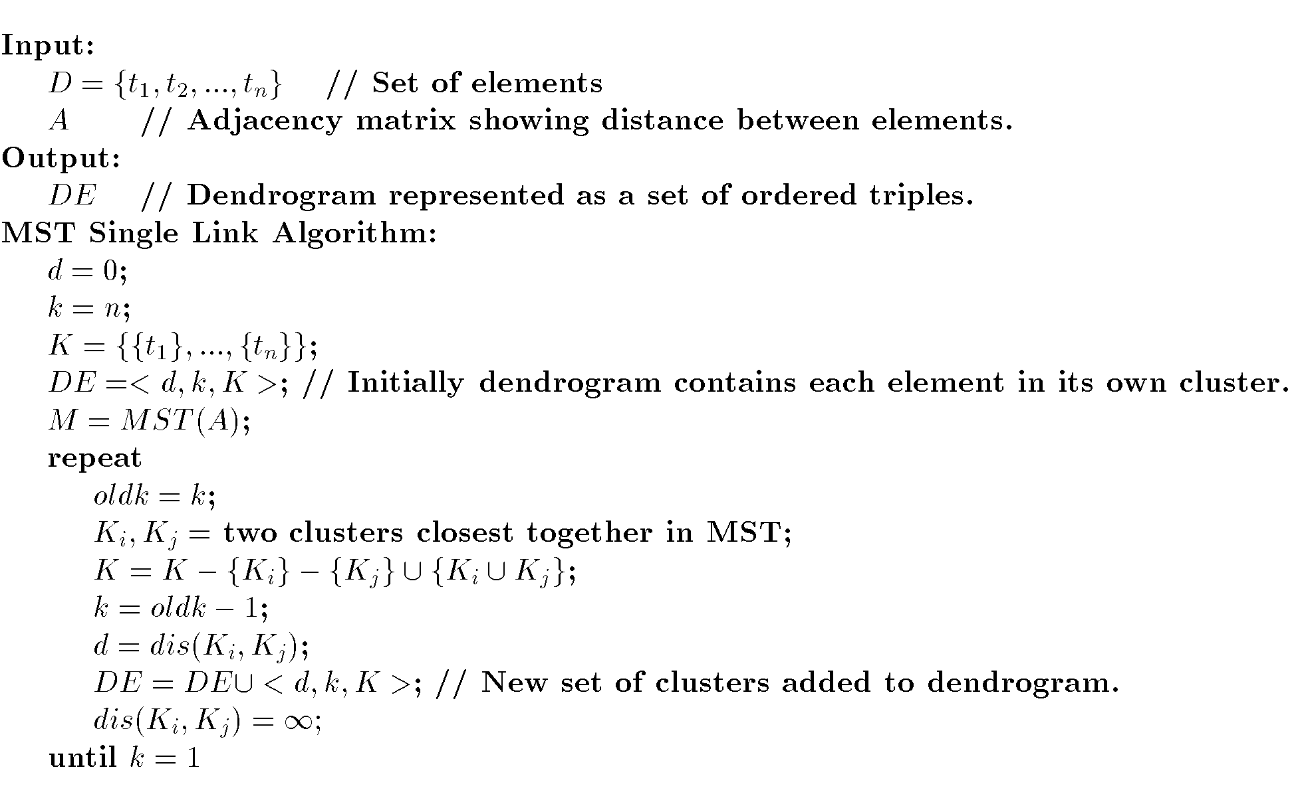
MST Single Link Algorithm

Slide 87
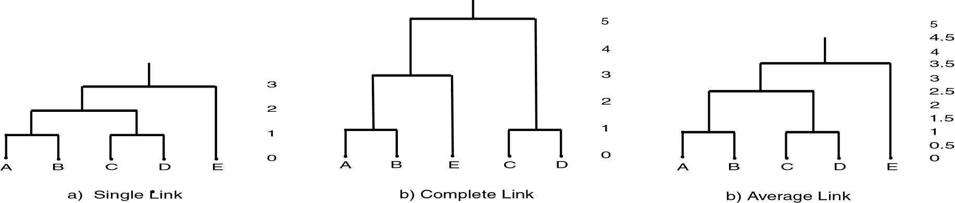
Single Link Clustering

Slide 88

AGNES (Agglomerative Nesting)
Introduced in Kaufmann and Rousseeuw (1990)
Implemented in statistical analysis packages, e.g., Splus
Use the Single-Link method and the dissimilarity matrix.
Merge nodes that have the least dissimilarity
Go on in a non-descending fashion
Eventually all nodes belong to the same cluster

Slide 89
DIANA (Divisive Analysis)
Introduced in Kaufmann and Rousseeuw (1990)
Implemented in statistical analysis packages, e.g., Splus
Inverse order of AGNES
Eventually each node forms a cluster on its own

Slide 90

ROCK: RObust Clustering using linKs
A Hierarchical Clustering Algorithm for Categorical Attributes
Example : Market Basket Data (Customer Transactions)

Slide 91
ROCK: RObust Clustering using linKs
Clustering based on neighborhood information
Two points, pi and pj, are neighbors if sim(pi, pj) ≥ threshold
If two similar points also have similar neighborhoods, then the two points likely belong to the same cluster and so can be merged.
More robust than standard clustering methods that focus only on point similarity

Slide 92
ROCK: RObust Clustering using linKs
In case of Market Basket Data, we can use Jaccard Similarity BT sets
A = {bread, milk, cola}, B = {bread, cheese, cola}

Slide 93
ROCK: RObust Clustering using linKs
ROCK first constructs a sparse graph from a given data similarity matrix using a similarity threshold and the concept of shared neighbors.
Then performs agglomerative hierarchical clustering on the sparse graph.
A goodness measure is used to evaluate the clustering.
Random sampling is used for scaling up to large data sets.

Slide 94

Chameleon: A Hierarchical Clustering Algorithm Using Dynamic Modeling

Slide 95

Chameleon: A Hierarchical Clustering Algorithm Using Dynamic Modeling

Slide 96

Chameleon: A Hierarchical Clustering Algorithm Using Dynamic Modeling

Slide 97

Chameleon: A Hierarchical Clustering Algorithm Using Dynamic Modeling

Slide 98

Chameleon: A Hierarchical Clustering Algorithm Using Dynamic Modeling
Uses a k-nearest-neighbor graph approach to construct a sparse graph,
Each vertex of the graph represents a data object,
There is an edge between two vertices (objects) if one object is among the k-most-similar objects of the other.
The edges are weighted to reflect the similarity between objects.
k-nearest-neighbor graph captures the concept of neighborhood dynamically: the neighborhood radius of an object is determined by the density of the region in which the object resides.

Slide 99
Chameleon: A Hierarchical Clustering Algorithm Using Dynamic Modeling
Uses a graph partitioning algorithm to partition the k-nearest-neighbor graph into a large number of relatively small subclusters.

Slide 100
Chameleon: A Hierarchical Clustering Algorithm Using Dynamic Modeling
Graph-partitioning algorithm partitions the k-nearest-neighbor graph such that it minimizes the edge cut.
A cluster C is partitioned into subclusters Ci and C j so as to minimize the weight of the edges that would be cut should C be bisected into Ci and Cj.
Edge cut is denoted EC(Ci, Cj) and assesses the absolute interconnectivity between clusters Ci and Cj.

Slide 101
Chameleon: A Hierarchical Clustering Algorithm Using Dynamic Modeling
Then uses an agglomerative hierarchical clustering algorithm that repeatedly merges subclusters based on their similarity
To determine the pairs of most similar subclusters, it takes into account both the interconnectivity as well as the closeness of the clusters.

Slide 102


Chameleon: A Hierarchical Clustering Algorithm Using Dynamic Modeling
Relative Interconnectivity
Relative Closeness

Slide 103

Chameleon: A Hierarchical Clustering Algorithm Using Dynamic Modeling

Slide 104

DBSCAN: Density Based Clustering

Slide 105

DBSCAN: Density Based Clustering

Slide 106
DBSCAN: Density Based Clustering
Density based clustering locates dense regions separated by sparse regions
Density: The number of points within a specified radius (Epsilon)
A point is a core point if it has more than a specified number of points (MinPts) within Eps (These are points that are at the interior of a cluster)
A border point has fewer than MinPts within Eps, but is in the neighborhood of a core point

Slide 107
Border & Core Points
Outlier
Border
Core
ε = 1unit
MinPts = 5

Slide 108
(Indirectly) Density-reachable:
p
p₁
q
Density-connected
p
q
o

Slide 109
DBSCAN: The Algorithm
Search for clusters by checking the ε-neighborhood of each point in the database
If the ε-neighborhood of a point p contains more than MinPts, a new cluster with p as a core object is created.

Slide 110
DBSCAN: The Algorithm
select a point p
Retrieve all points density-reachable from p wrt ε and MinPts.
If p is a core point, a cluster is formed.
If p is a border point, no points are density-reachable from p and DBSCAN visits the next point of the database.
Continue the process until all of the points have been processed.
Result is independent of the order of processing the points (except for border points)

Slide 111

DBSCAN: Density Based Clustering

Slide 112

DBSCAN: Density Based Clustering

Slide 113
K-D Tree
Finding nearest neighbors efficiently
(1,9), (2,3), (4,1), (3,7), (5,4), (6,8), (7,2), (8,8), (7,9), (9,6)
Note that it’s an approximation of NN

Slide 114
OPTICS
DBSCAN needs Eps and MinPts parameters from the user
It is sensitive to these parameters
Optics tires to overcome this by setting a dynamic eps threshold wrt minpts

Slide 115

OPTICS

Slide 116

Source

Slide 117


Slide 118
Readings
CHAMELEON: A Hierarchical Clustering Algorithm Using Dynamic Modeling. George Karypis, Eui-Hong Han, Vipin Kumar, IEEE Computer 32(8): 68-75, 1999 (http://glaros.dtc.umn.edu/gkhome/node/152)
A Density-Based Algorithm for Discovering Clusters in Large Spatial Databases with Noise. Martin Ester, Hans-Peter Kriegel, Jörg Sander, Xiaowei Xu. Proceedings of 2nd International Conference on Knowledge Discovery and Data Mining (KDD-96)
BIRCH: A New Data Clustering Algorithm and Its Applications. Data Mining and Knowledge Discovery Volume 1 , Issue 2 (1997)

